Slide 1
Third Sprint
Team RCM
By: Ramiro Gamboa Montes, Christopher Ramirez, Maggie Hemond

Slide 2
Our Hopes & Dreams
What we wanted to get done:
Stock Page:
Fictional money
buy fractions of stocks
Settings:
Light/Dark theme toggle fix.
Integrate a better API:
Use an API that allows us to see more stocks and has more features such as an auto fill (alpha vantage).
CSS:
Improve Formatting.

Slide 3
Back-End: The Harsh Reality
Started Firebase Integration Beginnings
Started integrating Firebase into the app’s backend.
Explored both Node.js and Python Cloud Functions to fetch and cache stock data (went with python)
Started Firestore Setup
Configured Firestore and deployed a sample function to write dummy stock data.
Learned to use environment configuration (via Firebase CLI and environment variables) to manage API keys securely.
All this lives on a private server for now, as we still us "legacy" code which would be yfinance. Another note is this can all be simply moved over to "render" however we wanted to minime the number of applications we use (React, Render, python, firebase)

Slide 4
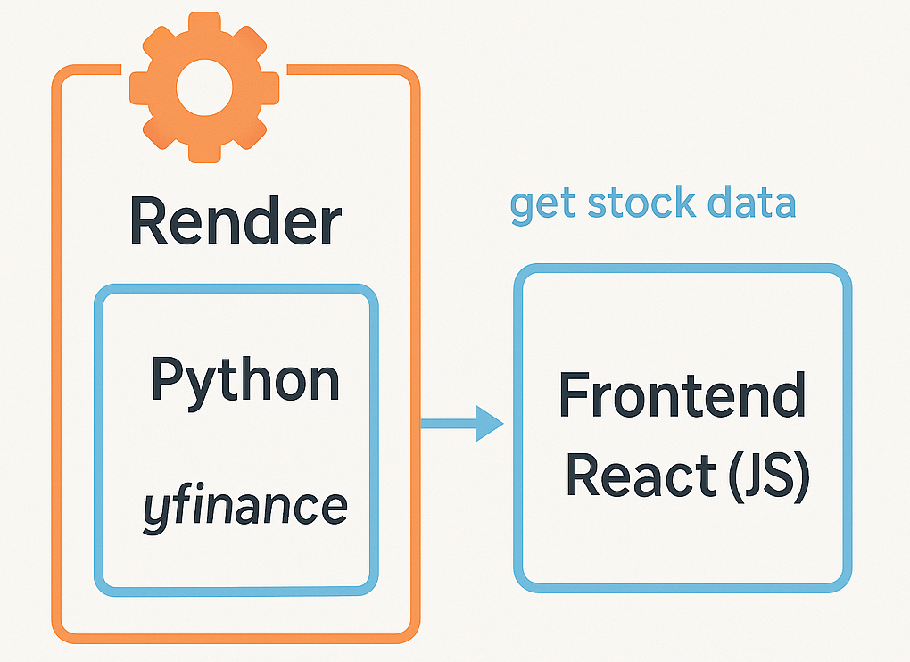
Back-End: The Harsh Reality

Slide 5
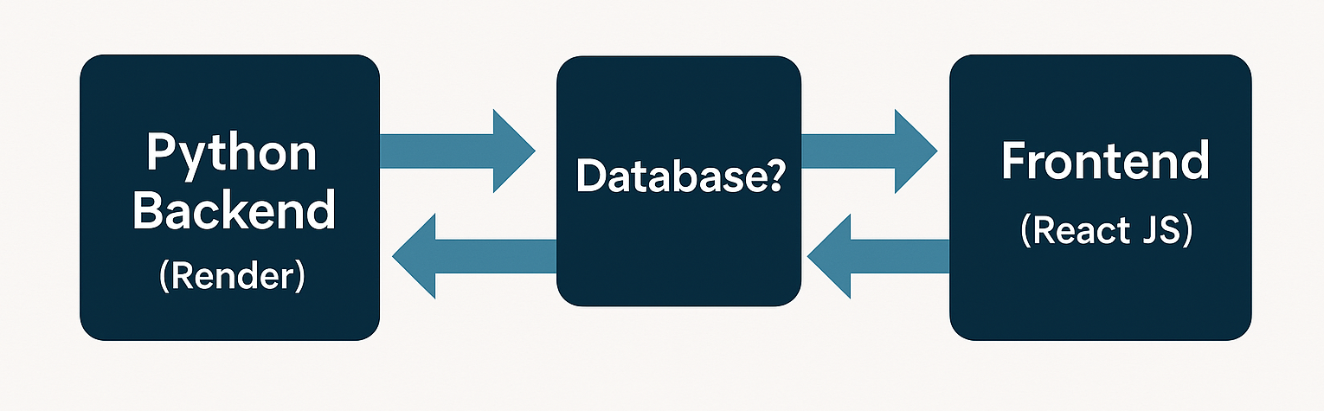
Future Backend Enhancements
Finalize stock info: We have figured out that alpha vantage is pretty good! Perhaps we'll add a database for caching or use a combination of both yfinance and alpha vantage.
Firebase authetication: We need to store people's portfolios at some point since we are a web-app and do not have local storage.

Slide 6
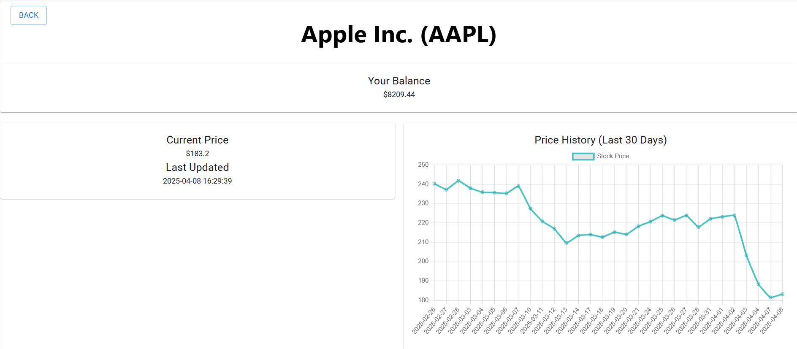
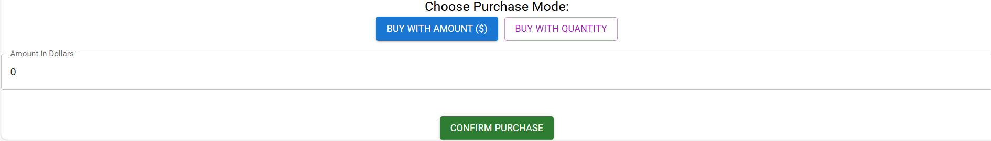
Stock Page: Current Developments
Worked on:
We can buy stocks with fictional money
We can buy fractions of stocks

Slide 7
Settings: Current Developments
Worked on:
The light and dark theme got broken. Fixed the Light/Dark theme
CSS: Current Developments
Worked on:
Got some CSS styling for the pages. Examples are text-align, margin, and font-family

Slide 8
Future Developments
Want to work on:
API Security: Currently, the API endpoint is public; implement authentication to restrict access.
Portfolio:
Gain/loss of all of portfolio
save portfolio so it does not disappear
Stock page:
Method of presentation on stock page (EndLess scroll and sections)

Slide 9
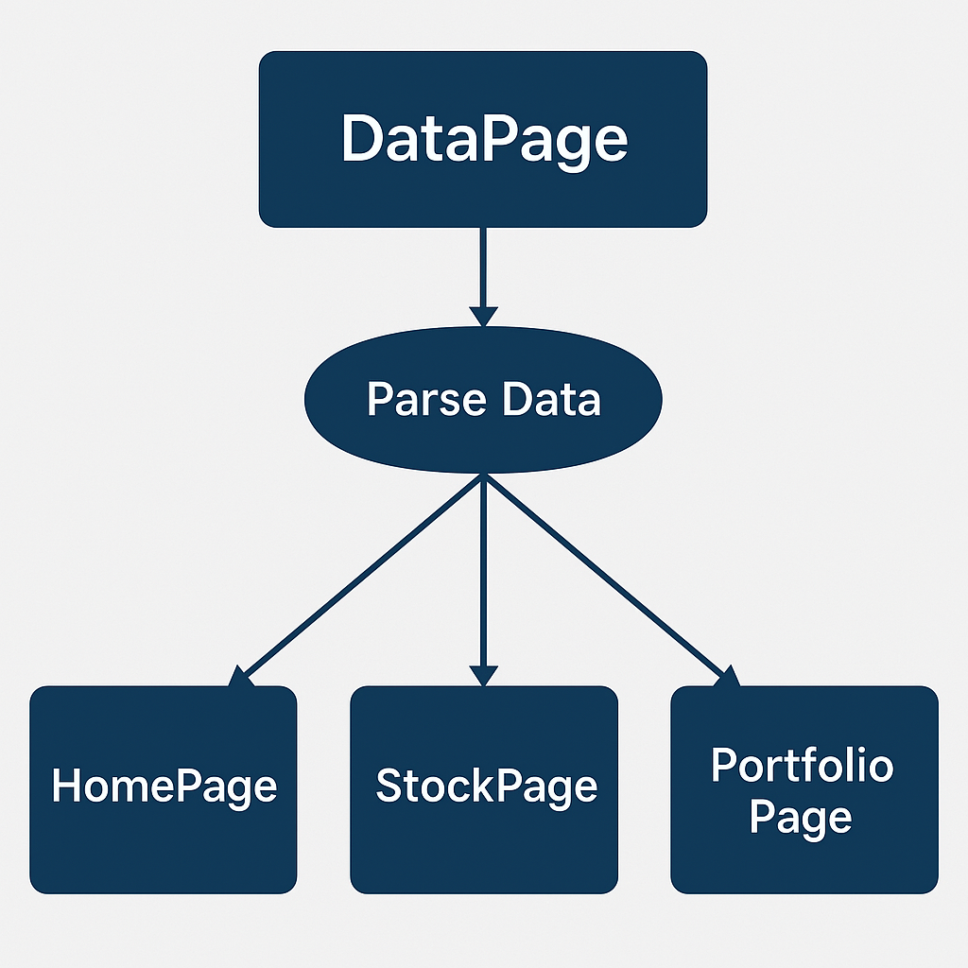
Overall future ideas
Currently, each component is responsible for fetching and processing its own data. To increase efficiency, we could implement a centralized data processing page that handles data parsing for all components, streamlining the process and reducing redundant requests.
Continue to work on each of the pages adding the features we want

